Slide 1
Year in Review
ILG Ethics Program

Slide 2
Ethics
Transparency
Public Engagement
Public Trust & Confidence = Competence +

Slide 3
Ethics Program Funding

Slide 4
Ethics Program Funding
Budget: $104,000

Slide 5
Ethics versus Ethics Laws
Ethics = what we ought
to do
Laws = what we must do
Minimum standards
Penalties

Slide 6
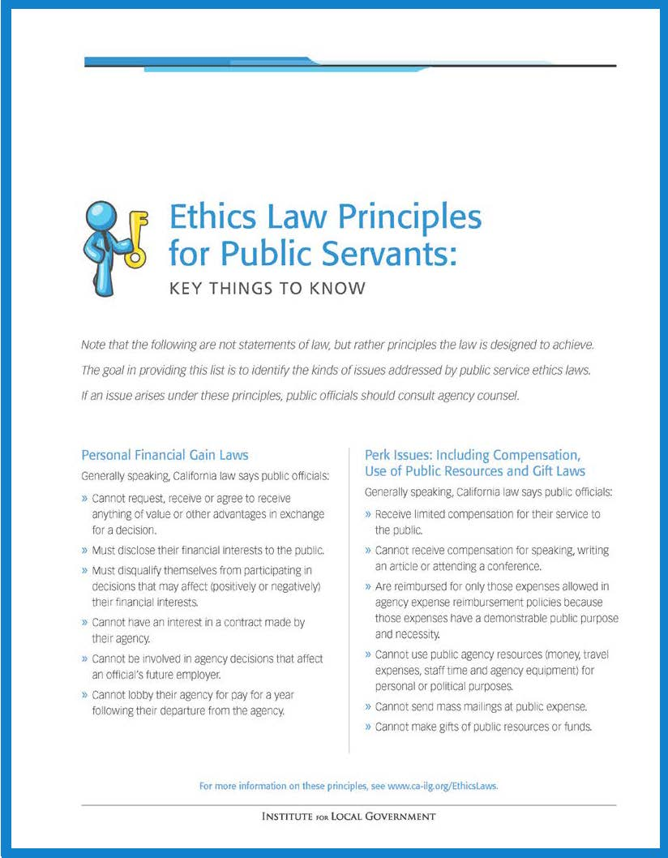
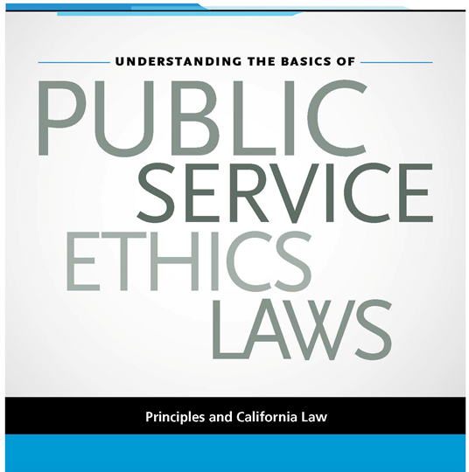
Two Updated Legal Publications

Slide 7
Everyday Ethics Column

Slide 8
2013 Everyday Ethics Columns
Attorney ethics
Difficult meeting situations
Use of public resources (trilogy)
Changes to the gift rules (forthcoming)

Slide 9
Distribution
League and CSAC channels
E bulletins
Western City
Special subgroups (attorneys, county counsels)
To special districts associations
Conference sessions
Own and others

Slide 10
AB 1234 Training and Materials
Do offer the training on a limited basis
Updated our slides/train the trainer materials

Slide 11
Other Highlights/Impacts
“The Front Page Test” Second Most Popular Western City article
Bell Website Story

Slide 12
