Slide 1
Meaningfully Engaging the Community in the Budget Process
ILG Webinar
March 5, 2014
10:00am – 11:00am

Slide 2
Speakers
Bill Statler, Consultant/Trainer, Retired Director of Finance & Information Technology, City of San Luis Obispo
Lauren Vasquez, Senior Management Analyst, City of Monrovia City Manager’s Office
Presider
Sarah Rubin, Program Manager, Public Engagement Program, Institute for Local Government

Slide 3

ILG Mission
Promoting good government at the local level
Practical, impartial and easy-to-use materials
Notes:
The Institute for Local Government promotes good government at the local level with practical, impartial and easy-to-use resources for California communities. ILG’s resources are in many areas including ethics, collaboration, public engagement and sustainable communities. ILG is the research and education affiliate of the California State Association of Counties and the League of California Cities.

Slide 4
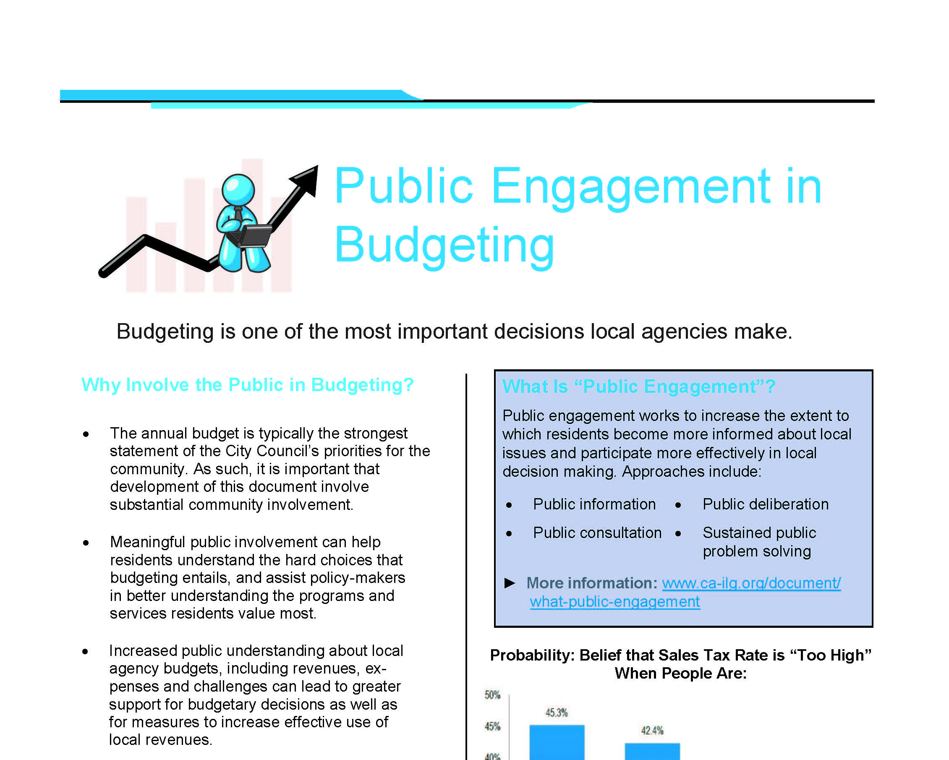
ILG Public Engagement and Budgeting Resources
Publications, tools and case story examples available here:
http://www.ca-ilg.org/engaging-public-budgeting

Slide 5
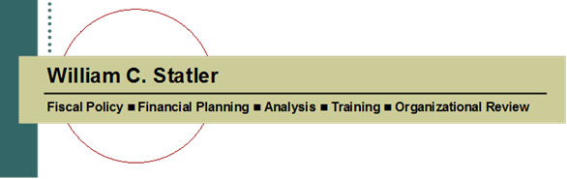
Meaningfully Engaging the Community in the Budget Process
March 5, 2014

Slide 6
Community engagement in the budget process
Doing this meaningfully means first asking:
  Engaging them in what?
  And why?

Slide 7
Why engage the Community?
The Budget is typically the strongest statement of the City’s priorities for the community. As such, important that its development involve substantial community involvement.
Meaningful public engagement helps residents understand the hard choices that budgeting entails.
And assists policy-makers in better understanding programs and services residents value most.
http://www.ca-ilg.org/public-engagement-budgeting
http://www.ca-ilg.org/post/local-officials-guide-public-engagement-budgeting

Slide 8
Why Engage the Community?
Increased public understanding about local agency budgets, including revenues, expenses and challenges can lead to greater support for budgetary decisions as well as for measures to increase effective use of local revenues.
Transparency about the local agency finances and the budget decision-making process promotes public trust and confidence in stewardship of taxpayer funds.

Slide 9
Why Engage the Community?
The budgeting process allocates scarce taxpayer dollars to services, programs and facilities that play a key role in determining the community’s quality of life.
ICMA considers resident participation a core competency for successful public managers.
Stated simply, meaningfully engaging the community in key policy decisions that affect them is the right thing to do.

Slide 10
Engaged in what?
What is the desired outcome?
How will a broad range of stakeholders be engaged?
How will the input be used in budget decision-making?
Be clear on this at the onset.

Slide 11
Tools to Consider
Surveys
Advisory Bodies
Online Forums (Social Media)
Workshops
  Opportunities for information sharing, discussion and feedback on budget goals and issues.
Deliberative Forum
  Similar to a workshop but usually involves more information sharing and increased time for participant dialogue
Participatory Budgeting

Slide 12


A Tale of Two Cities

Slide 13


  44,000 residents
  Central Coast
  General Fund: $60 million
  Historic Mission Community
  Government, Business & Cultural Center of the Central Coast
    Cal Poly
    Tourism
    State and Region-Wide Governmental Services
  38,000 residents
  Central Los Angeles County
  General Fund: $10 million
  90% of residents Hispanic
  One of poorest cities in Los Angeles County
    Almost one in six residents lives below the poverty line
    Unemployment: 16%

Slide 14

Purpose of the City’s Budget
Like most cities, SLO has a bunch of long-term policies and plans:
  General Plan (and all its elements)
  Water and Wastewater Master Plans
  Pavement Management Plan
  Access and Parking Management Plan
  Short-Range Transit Plan
  Bicycle Plan
  Public Art Policy
  Downtown Plan
  IT Strategic Plan
The budget is the key tool for programming the implementation of these plans by allocating the resources needed to do so.
  Over the next two-years, which of all these goals – many of which compete for the same resources – will get done.
  And which ones won’t.

Slide 15
Because . . . .
Your agency can do anything.
It’s everything it can’t do.

Slide 16
Linking Goals and Resources
This requires a process that:
  Clearly identifies the “highest priority, most important” things for the City to do during the next two years at the beginning of the process.
    Goal-setting should drive the budget process, not follow it.
  Establishes reasonable timeframes and organizational responsibility for getting them done.
  Allocates required resources.

Slide 17
Five Step Goal-Setting Process
Budget Workshops and Forums – Before Issuing the Preliminary Budget
  ❶ Setting the Table (November)
  ❷ Building the Foundation (December)
  ❸ Community Forum (January)
  ❹ Council Goal-Setting (January)
  ❺ Major City Goal Work Programs (April)

Slide 18
❶ Setting the Table
Don’t start this process with a blank slate, so what’s on the menu?
  What the status of General Plan implementation?
  What are long-term CIP needs through General Plan build-out?
  What’s the status of current major City goals and objectives?
  What’s the status of current CIP projects?
  What’s the general fiscal outlook?

Slide 19
❷ Building the Foundation
Finalize the goal-setting process
Review (and modify as appropriate) budget and fiscal policies
Review and discuss audited financial results for prior year (CAFR)
General Fund five-year fiscal forecast

Slide 20
❸ Community Forum
Extensive preparation for well-attended community forum
  Letters to over 200 community groups and interested individuals
  Display ads in media
  Web site
  “Community Budget Bulletin” inserts in utility bills
  Lot’s of thought and planning on what this should look like

Slide 21
❹ Council Goal-Setting
All day workshop to answer the question:
What are the most important, highest priority things for the City to accomplish over the next two years?
Council members provide 5 to 7 goals before workshop, organized by staff by “themes;” distributed before workshop
With help of professional facilitator and use of previously-agreed ranking process, organized into three priorities:
  Major City Goals
  Other Council Objectives
  Address as Resources Permit

Slide 22
❺ Major City Goal Work Programs
We need to:
  Clearly define and scope the work
  Ensure clear understanding of how to accomplish the goal
  Convert the goal into specific action steps so we can measure progress in achieving it.
  And assure that we link the “action steps” with required resources
Detailed Work Programs
  Objective
  Discussion: key issues, background, challenges
  Action Plan: Key steps and schedule
  Responsible Department
  Required Resources
  Outcome: Final Work Product

Slide 23
Goal-Setting and the Budget Process
Advisory Bodies
Letters from Community Groups
Goal-Setting Input
July to January
Community Surveys
Letters from Individuals
Community Forum
Fiscal Forecast **
Council Goal Setting
Workshop
January
Current 2-Year
Goals *
Long-Term Plans,
Goals & Policies *
* November “Setting the Table” Workshop
** December “Budget Foundation” Workshop
Major City Goal Work Programs and “Strategic Budget Direction:” April
Preliminary Budget: May
Budget Workshops: June
Adopted Budget: By June 30

Slide 24
Advisory Bodies
What are the most important, highest priority things for the City to do over the next two years?
  Architectural Review Commission
  Bicycle Committee
  Cultural Heritage Committee
  Downtown Association
  Housing Authority
  Human Relations Commission
  Jack House Committee
  Joint Recreational Use Committee
  Mass Transportation Committee
  Parks and Recreation Commission
  Planning Commission
  Promotional Coordinating Committee
  Tree Committee

Slide 25
Advisory Bodies
Briefing with Chairs/Mayor at Quarterly Meeting
Briefing with support staff
Presentations at meetings
Results shared with all advisory bodies

Slide 26
Community Groups
Over 200 community groups and interested individuals invited to participate in the process

Slide 27
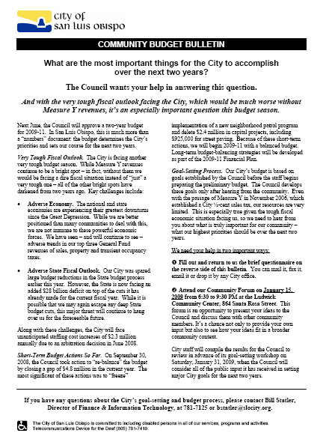
Community Budget Bulletin
14,000 inserted into City utility bills

Slide 28
Community Budget Bulletin
What are the most important things for the City to accomplish over the next two years?

Slide 29
Community Budget Bulletin Results
Over 400 responses
15 “Top Themes”
  Street repair/neighborhood paving
  Open space preservation
  Traffic congestion relief
  Public safety
  Creek & flood protection
  Senior services & facilities
  Neighborhood code enforcement
  Downtown protection/enhancement
  Spending reductions
  Bikeway improvements
  Binding arbitration repeal
  Parks & recreation
  Transit system
  Homeless concerns
  Affordable housing

Slide 30
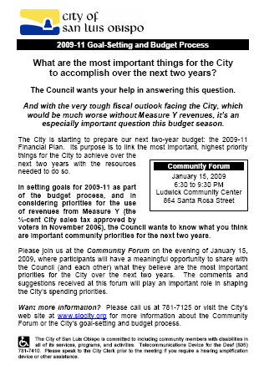
Display Ads

Slide 31
Community Forum
275 participants
Great learning opportunity – for community, Council and staff
Agenda
  Welcome
  Introduction: City’s budget process; status of current goals; general fiscal outlook; Forum purpose and approach
  Public Comments
  Post-its”
    Green: Resource Suggestions
    Pink: Questions or Concerns
  “Voting with Dots”
  Feedback Survey

Slide 32
Community Forum Feedback

Slide 33
Budget Balancing Ideas

Slide 34
Community Forum Outcome
Great sense of community
“Voices heard”
Opportunity for dialog
Great feedback
Deliverables
  275 participants
  68 speakers: “what & why”
  “Voting with dots” on priorities
  Survey results
    “Level of attention” on services (less, same, more)
    Potential revenue enhancements
    Potential service reductions
    Ways to achieve goals

Slide 35
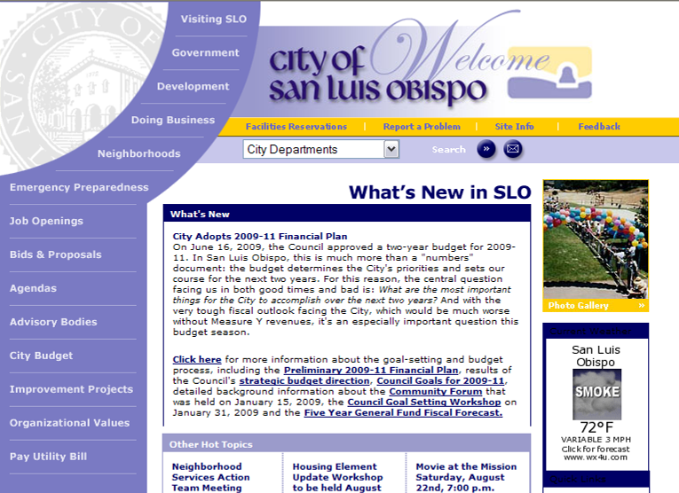
Web Site

Slide 36
And after goal-setting
Some more notice!

Slide 37
Budget-in-Brief
  Mailed to all residents and businesses
  On City web site (along with other budget information and financial reports)
www.slocity.org/finance/budget.asp

Slide 38
Process relies on one simple question
What are the most important, highest priority things for the City to accomplish over the next two years?

Slide 39
Doesn’t this raise false expectations?
No.
  While they may appear to be, goal-setting and tough fiscal times are not conflicting concepts.
  In fact, the need to set goals for the most important, highest priority things for us to do is even more important when resources are tight.
  And creating meaningful opportunities for community involvement provides the best possible “campfire” for telling your fiscal story.

Slide 40
This Is the Essence of the Budget Process
Of all the things we want to do in making our community an even better place to live, work and play, what are the most important?
  In tough fiscal times, this may mean that preserving existing essential services is the highest priority.
And making difficult resource trade-offs to do them is what the budget process is all about.

Slide 41

City of Bell
Similar process, but unique challenges
  Large Spanish-speaking population
  Deep distrust in the aftermath of well-publicized scandals

Slide 42
A better story for this year
Este año el proceso es mucho mejor
The Council publicly established the schedule and process very early
Public involvement is underway – over six months before budget adoption
Multiple opportunities for public participation throughout
El Concejo Municipal definió el calendario y el proceso públicamente y con mucha anticipación
El público ya está participando, más de seis meses antes de que se apruebe el presupuesto
Existen múltiples oportunidades para la participación del público durante todo el proceso

Slide 43
Small Groups
English or Spanish speaking table
Randomly assigned
Two-facilitators per table
  Volunteer/staff
  Training beforehand
Brief presentation on process and fiscal challenges facing the City
Same table topic for all groups

Slide 44
Today’s Big Question
La Gran Pregunta de Hoy
What are the most important things to accomplish next fiscal year (2012-13)?
Keeping in mind …
  We can’t do it all
  Achieving many of the goals will take more than 1 year
  Council must weigh many ideas and financial constraints
¿Cuáles son las metas más importantes para el próximo año fiscal (2012 -2013)?
Tengan presente…
  No podemos hacer todo lo que quisiéramos
  Alcanzar estas metas podría requerir mas de un año
  El Concejo tendrá que analizar muchas ideas y nuestra limitaciones fiscales

Slide 45
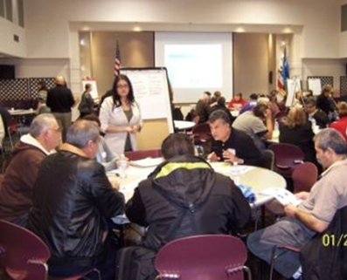
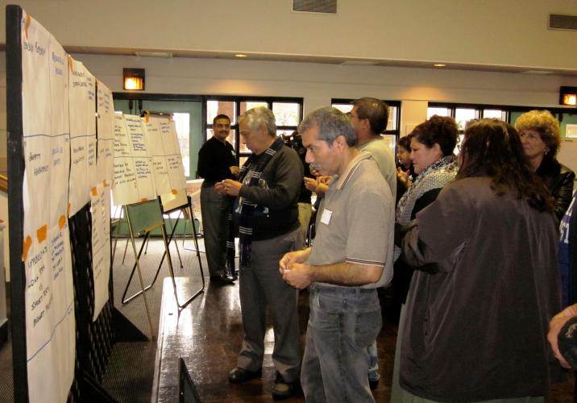
Engaged Process
Facilitated discussion by each group
Reporting out on top priorities
Ranking priorities (“voting with dots”)
Wrap-up/Next steps
www.ca-ilg.org/BellBudgetForum

Slide 46
Final Thoughts: Not a Panacea
Meaningful community engagement is essential for community trust in stewardship of public resources and legitimacy of budget outcomes.
But tough decisions by staff and elected officials are still necessary.
  Meaningful consideration of public input necessary, but one factor among many that need to be weighed by governing bodies.

Slide 47
Recent IBM Report
Managing Budgets During Fiscal Stress: Lessons For Local Government Officials
  Finding: “Community engagement and budget transparency are important and do help, but will not supplant the need to make difficult decisions that involve costs or burdens to residents and community stakeholders.”
  Recommendation: “Foster citizen engagement to encourage widespread dissemination of fiscal information in order to enhance the legitimacy of public policy choices.”
  http://www.businessofgovernment.org/report/managing-budgets-during-fiscal-stress-lessons-local-government-officials

Slide 48




PLAN
MONROVIA
Envision LOCAL

Slide 49

Strategic Plan Purpose
Primary Goal: Strategic Plan priorities and work programs guide budget decisions, including preparation of upcoming 2013-15 Budget
  What are the most important things for the City to focus on over the next five years?
http://www.ca-ilg.org/public-engagement-case-story/city-monrovia-budget-eduction-and-outreach-story

Slide 50
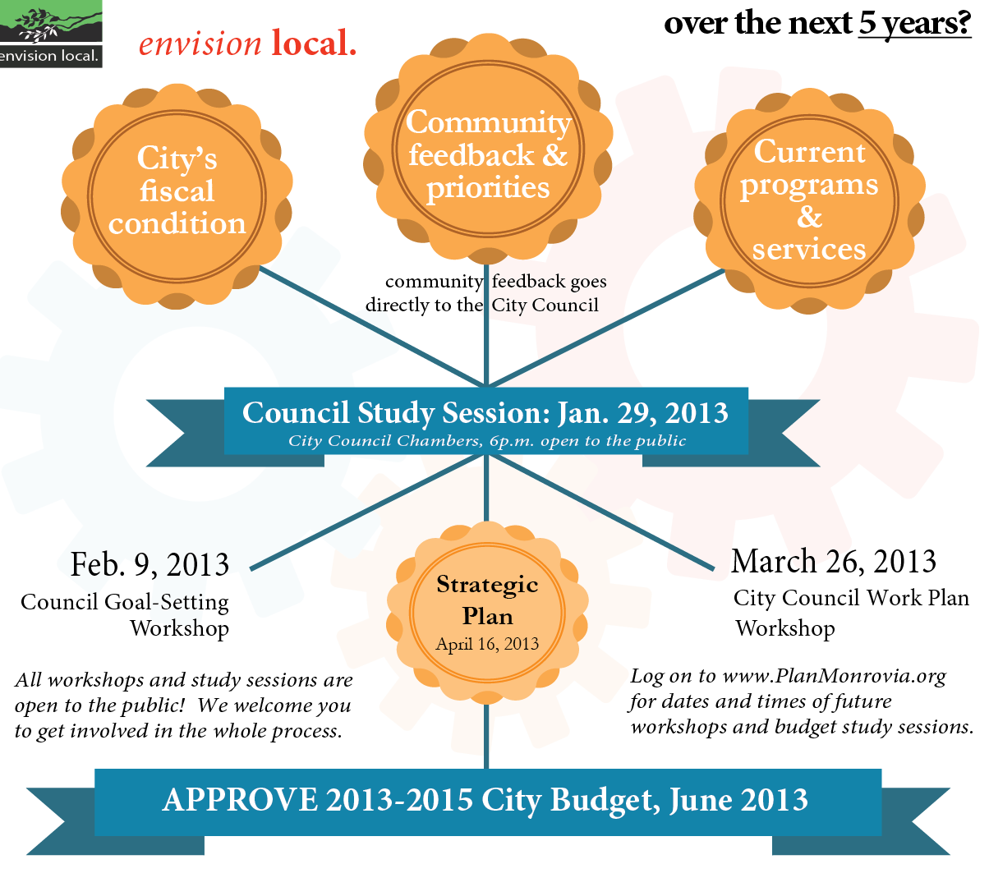

Plan Monrovia Process

Slide 51
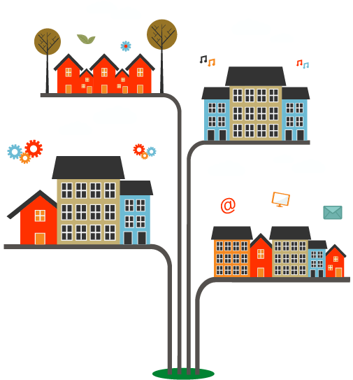
Marketing & Outreach
The Plan Monrovia Marketing and Outreach was designed to reach the greatest number of Monrovians, so that as Council developed a final plan, you would see a greater community snapshot.
Notes:
2012-13 Budget Process, Calendar and Document
November 9, 2011
51

Slide 52
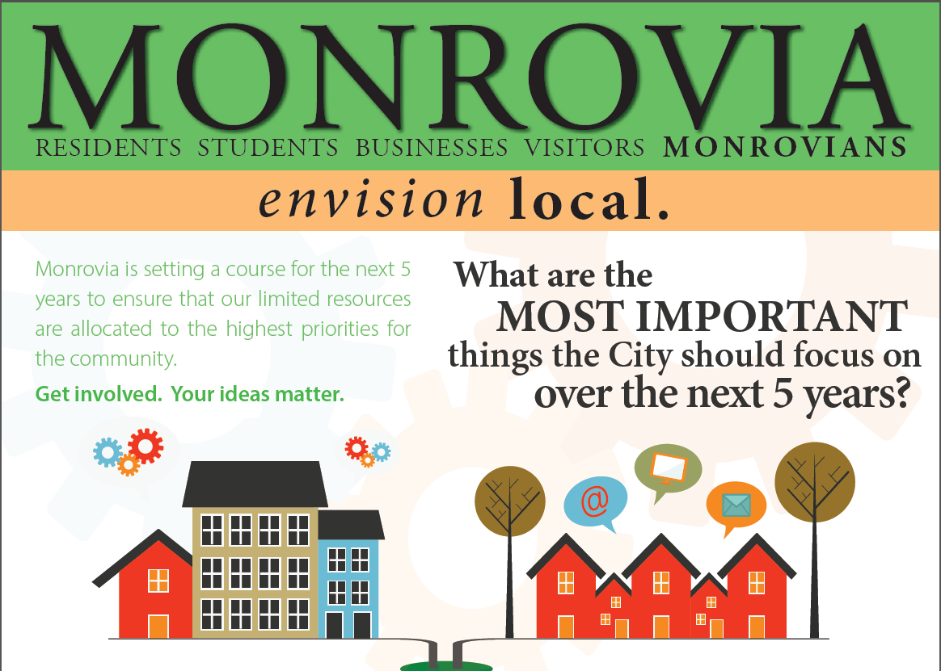

Marketing & Outreach
Traditional / Low Tech Marketing
Trifold Brochure
Flyers
Posters
Postcards
Banners
Community Roadshow
presentations
Email / Phone
Notes:
2012-13 Budget Process, Calendar and Document
November 9, 2011
52

Slide 53


Marketing & Outreach
Out of the Box / High Tech Marketing
City of Monrovia website
Twitter, @MonroviaCA, #PlanMonrovia
Facebook, City of Monrovia
Textizen
MindMixer (web)
Notes:
2012-13 Budget Process, Calendar and Document
November 9, 2011
53

Slide 54
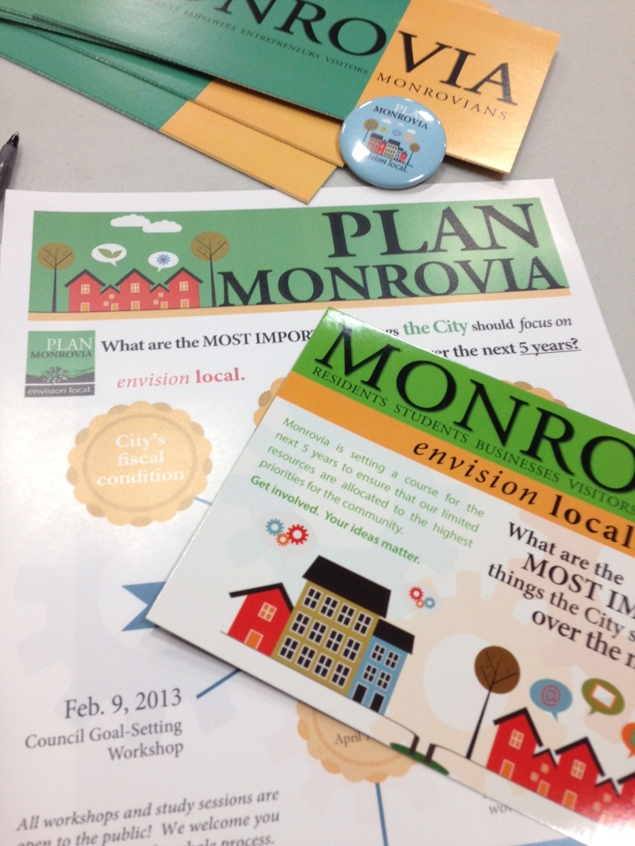
Community Outreach Efforts
Over 60,000 potential stakeholders were reached through various mediums such as:
  Road Show Outreach- 6,118 people directly reached
  Written Surveys- Over 10,000 surveys were distributed with over 200 responses
  Community/Public Workshops- 160 participated
  PlanMonrovia.org- 164 participated
  Press and marketing – Approx 45,000 received information on PlanMonrovia
Notes:
2012-13 Budget Process, Calendar and Document
November 9, 2011
54

Slide 55


MONROVIA
RESIDENTS STUDENTS BUSINESSES VISITORS MONROVIANS
Outreach and Council Setting Results

Slide 56
Major Goals and Priorities

Slide 57
Major Goals and Priorities Continued

Slide 58
MONROVIA
RESIDENTS STUDENTS BUSINESSES VISITORS MONROVIANS
Work Plans

Slide 59
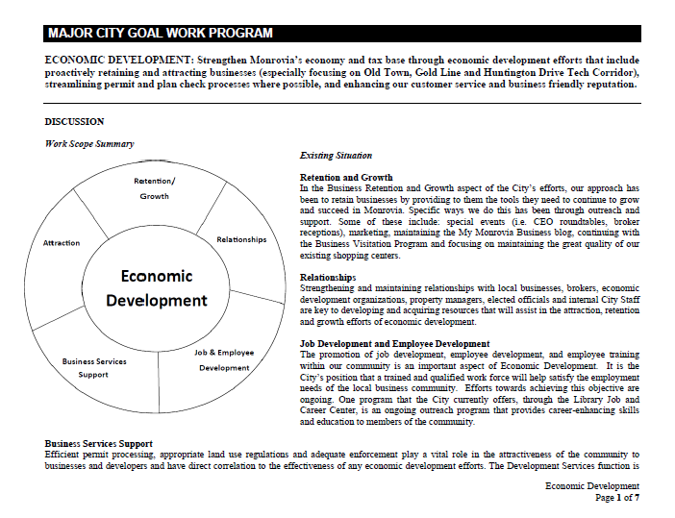
Major Goal Work Plans

Slide 60
MONROVIA
RESIDENTS STUDENTS BUSINESSES VISITORS MONROVIANS
Plan Monrovia Strategic Plan

Slide 61
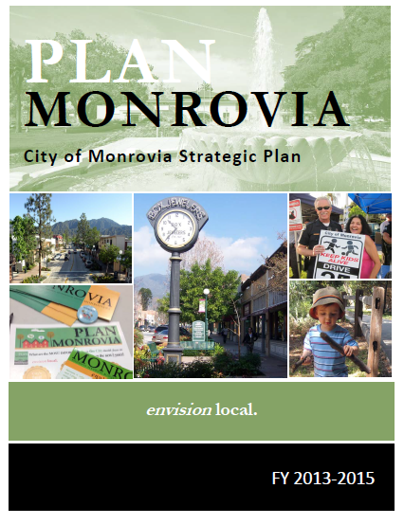
Plan Monrovia Strategic Plan
Plan consists of:
Executive Summary
Work Plans
List of Council’s Goals set on 2/9/13
Community Outreach report
The Plan and Progress reports can be viewed on the City site: www.cityofmonrovia.org
Just Click on Plan Monrovia
Notes:
Plan consists of:
Executive Summary
The Work Plans with a nifty Cheat Sheet that can be used to easily view the work plans and all activities
List of Council’s Goals set on feb. 9th
And the full Community Outreach report
The Plan can view on the City website by clicking on the Plan Monrovia tab from the home page

Slide 62
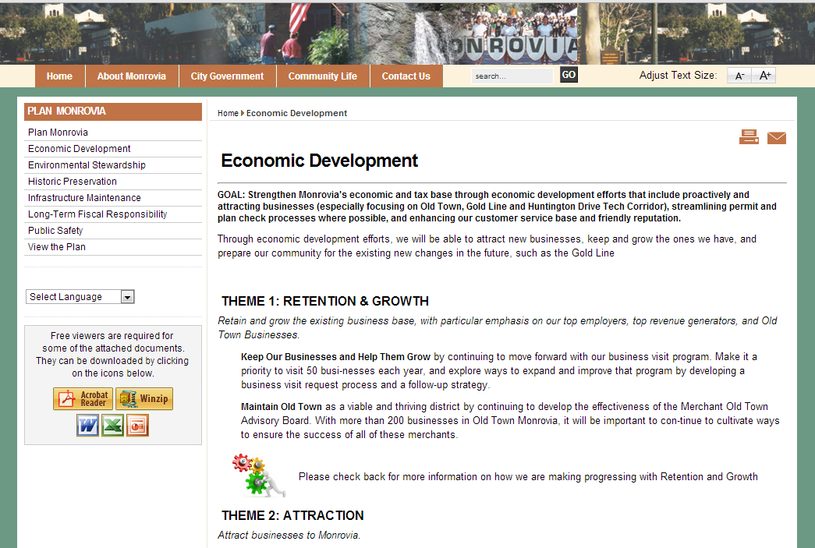
Reporting Back Results
Progress Reports and Monitoring
Notes:
From the Plan Monrovia page (click for red circle) you can view the full plan as well as view any updates on the work being done in each of the goals.

Slide 63
MONROVIA
RESIDENTS STUDENTS BUSINESSES VISITORS MONROVIANS
Incorporating Plan Monrovia into the Budget

Slide 64
The Plan & Budget
Took the Plan and incorporated into the 2013-2015 Budget process
Identified both funded and unfunded items
Adopted a budget that was developed using the Plan

Slide 65
MONROVIA
RESIDENTS STUDENTS BUSINESSES VISITORS MONROVIANS
Takeaways

Slide 66
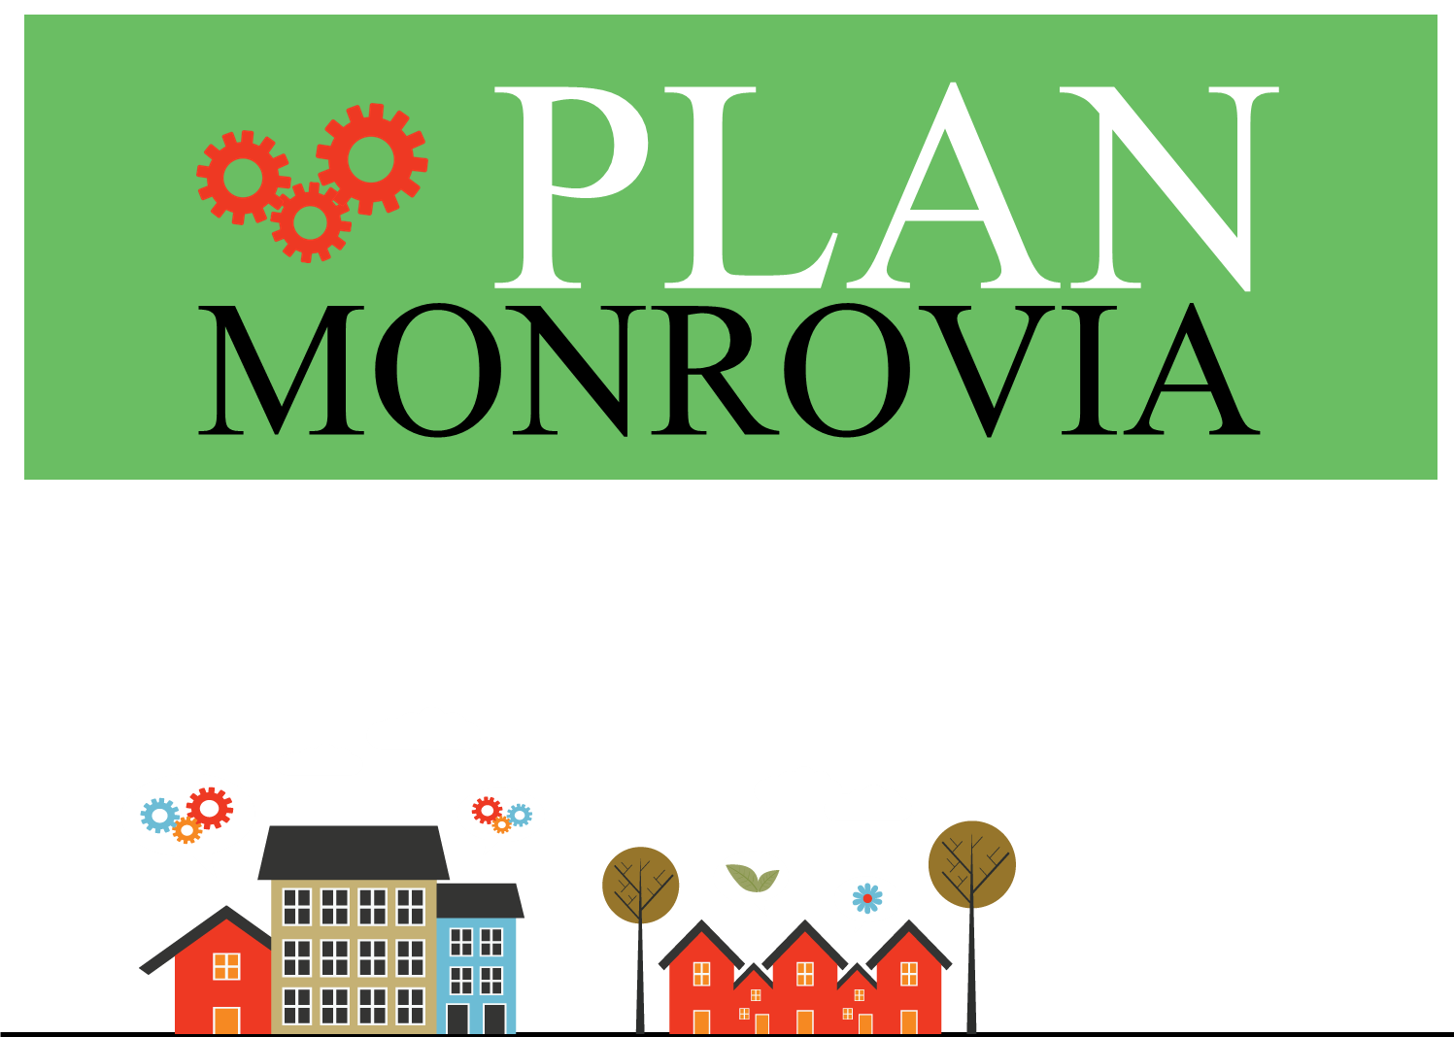
Strategic Planning Do’s to Keep in Mind
Promote community engagement
Hire third-party consulting firm
Form an employee group, such as MIT9, to plan, develop and promote community engagement events
Consider how an election year might impact the outcome.

Slide 67
Strategic Planning Do’s to Keep in Mind…Con’t
Consider how the venue for the community workshop might change the focus of priorities
Consider how much information the community may need to assist with developing priorities. Perhaps, explaining the current budget and whether there is a surplus or a shortfall
Need an effective method for getting Council to agree on goals in a timely way

Slide 68



Questions?
http://www.ca-ilg.org/public-engagement-case-story/city-monrovia-budget-eduction-and-outreach-story

Slide 69
Thank You!
The webinar recording and PowerPoint slides will be available
on ILG’s website shortly
http://www.ca-ilg.org/webinar/how-ensure-your-budget-meets-your-communitys-needs
If you have additional questions please contact Melissa Kuehne: 916 658-8202

