Slide 1
Dealing with Deeply Held Concerns and Organized Opposition in Public Engagement Activities
SCLN Brownbag Webinar Series
March 13, 2013
10:00am – 11:15am
www.ca-ilg.org/webinarbasics

Slide 2
Speakers
Brian Moura, Assistant City Manager, San Carlos
“San Carlos Addresses Controversy over Climate Planning and Action”
Susan Stuart Clark, Director, Common Knowledge
“Marin County Addresses Pension Reform and Controversy”
Presider
Christal Love Lazard, Program Coordinator, Public Engagement Program, Institute for Local Government

Slide 3
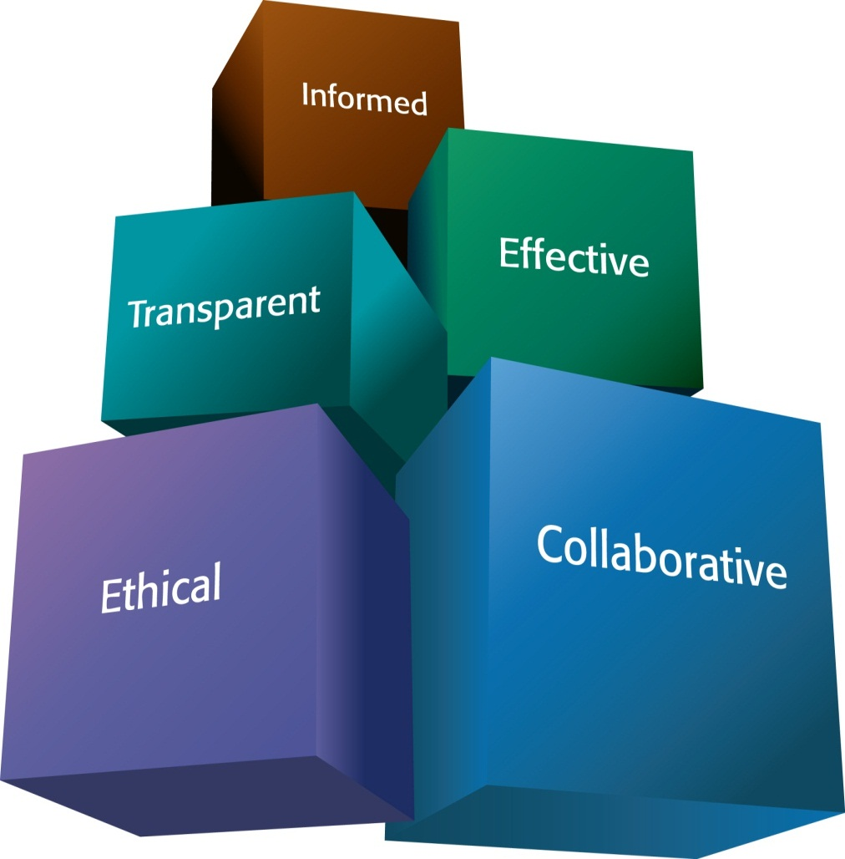
ILG Mission
Promoting good government at the local level
Practical, impartial and easy-to-use materials
Notes:
The Institute for Local Government promotes good government at the local level with practical, impartial and easy-to-use resources for California communities. ILG’s resources are in many areas including ethics, collaboration, public engagement and sustainable communities. ILG is the research and education affiliate of the California State Association of Counties and the League of California Cities.

Slide 4

Sustainable Communities www.ca-ilg.org/sustainability
Resources to:
Understand land use and planning basics
Learn about the benefits of healthy neighborhoods
Learn about climate change, reducing greenhouse gas emissions & saving energy
Share sustainability best practices through peer-to-peer learning network (www.ca-ilg/scln)
Notes:
The Sustainable Communities Learning Network helps local officials and staff to access and share resources and tools that encourage their communities to consider and apply economically, socially and environmentally sustainable practices.
The Learning Network:
Facilitates peer-to-peer learning, sharing of real-world examples between local officials and others engaged in sustainability efforts
Provides access to case stories, tools, and resources in ten Sustainability Best Practice areas
Offers opportunities to be recognized as a leader in sustainability

Slide 5
Featured Examples
Brian Moura
Location: City of San Carlos
Topic: City’s green programs
Susan Stuart Clark
Location: County of Marin
Topic: Pension Reform

Slide 6
Dealing with Deeply Held Concerns and Organized Opposition in Public Engagement Activities
Brian Moura
Assistant City Manager, San Carlos
bmoura@cityofsancarlos.org
March 13, 2013

Slide 7

San Carlos & Green Programs
Silicon Valley community
  Population: 28,000
  Highly Educated
  High Income
Environmental Program
  Council requested broader City program in 2007 in response to resident interest
  Partnering with other agencies to leverage results
Outreach & engagement – public & business a priority
  General Plan, Climate Action Plan, Polystyrene Ban, others

Slide 8


The Situation
Public Comment Item
  Agendize for discussion
  Report on what you learned
Issues Raised
  City membership in ICLEI
  UN Agenda 21 was a treaty
  Ranch zoning in Siskiyou County & future beef shortage
  Coastal Commission permits
  San Jose’s ABAG membership
Placed on Future Agenda

Slide 9
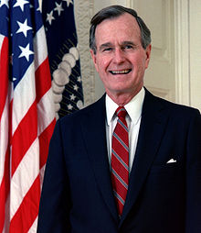
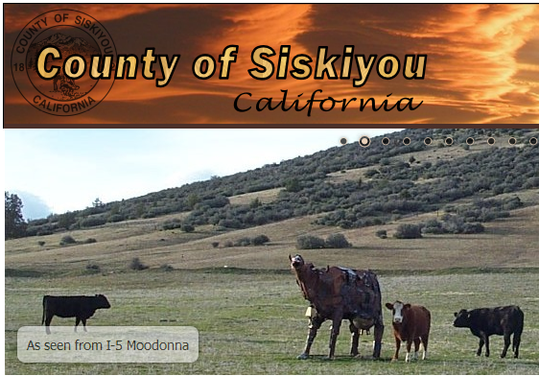
How It Was Handled
City’s Green Programs
  State mandates & regs
  Council actions to expand
  Partners: Climate Task Force, SC Green, Beacon Award
  UN and ICLEI are not factors
Outline the Issues
  Transcript of agenda request
Analysis & Options
  Reported what we learned
  Offered next step for each one
City Council reaffirmed
  Green Progs & ICLEI

Slide 10




Closing Thoughts & Advice
List State Laws & Regs that require actions
Discuss City programs & Council expansion
Clarify role that each group/resource plays
Offer next steps to take for Council, speakers
Audience: residents, media, speakers
City Council vote to reaffirm, bring closure

Slide 11
References
Beacon Award – City of San Carlos web site
  http://www.ca-ilg.org/beacon-award-participant-profile/city-san-carlos
Involving the Public in Climate Planning (ILG)
  http://www.ca-ilg.org/sustainability-case-story/city-san-carlos-involving-public-climate-change-action
American Planning Association (APA) – Agenda 21
  http://www.onebayarea.org/pdf/Agenda21mythsfacts.pdf
Video/Report: San Carlos Council Mtg – Jan 23, 2012
  http://www.epackets.net
Video: Glenn Beck on the UN’s Diabolical Plan
  http://www.youtube.com/watch?v=esJY2SK_4tE

Slide 12

CK
Effective Public Engagement
When Values and Beliefs Collide
March 13, 2013

Slide 13
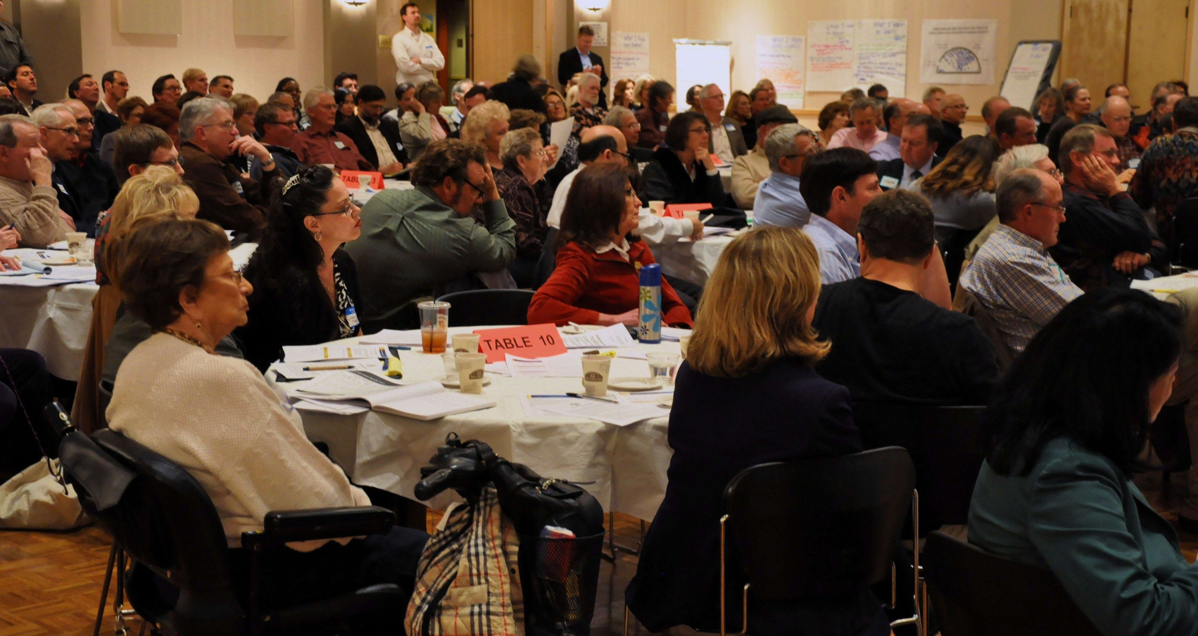
Also known as:
High Stakes Forums in Low Trust Environments

Slide 14
Topic: Public Employee Pensions
Players: County of Marin
• CAO staff
• Supervisors
Pension Reform Advocacy Group
Multiple Employee Unions
Local Newspaper

Slide 15
The Situation
Spring 2011 “hearing style” forum on Public Employee pensions frustrated reform advocates
Citizens for Sustainable Public Pensions (CSPP) formed and began attending BOS meetings; they wanted to have a new public forum
County staff agreed to planning process with CSPP that also included representatives from largest public employee unions in the County
Local newspaper highlighting CSPP concerns

Slide 16
Stakeholder Education
& Trust Building
Deliberation for
Decision Making
MUTUAL UNDERSTANDING

Slide 17
Essential Pre-Planning
Timing at pause in decision-making so session can develop mutual understanding
Choosing an inclusive neutral framing:
“What is sustainable?”
Expanded view of relevant stakeholders
Entire planning team agrees on “basic facts” (including where there isn’t agreement)
Carefully balanced panel & interactive format

Slide 18

Invite and Info in Multiple Formats
www.marincounty.org/Main/Pensions

Slide 19
Areas without agreement
1. How quickly should unfunded liability be paid off?
2. What “discount rate” to use?
3. What are employees’ rights for benefits? (“vested doctrine”)
4. What leeway does county government have to act with and without state action?

Slide 20
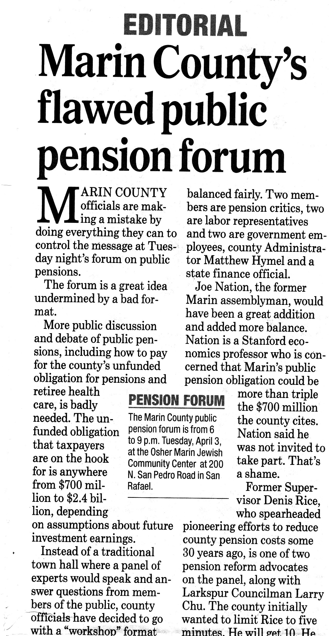
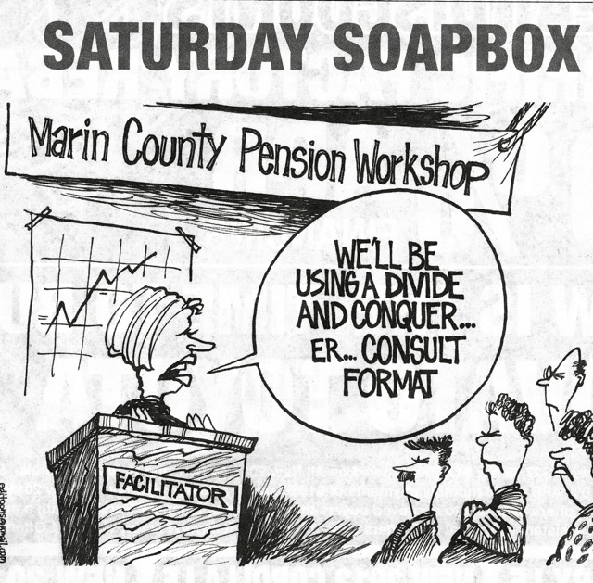
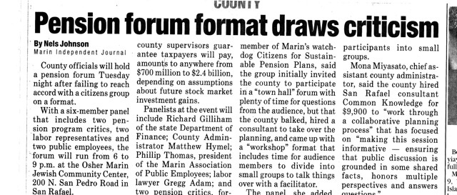

Slide 21
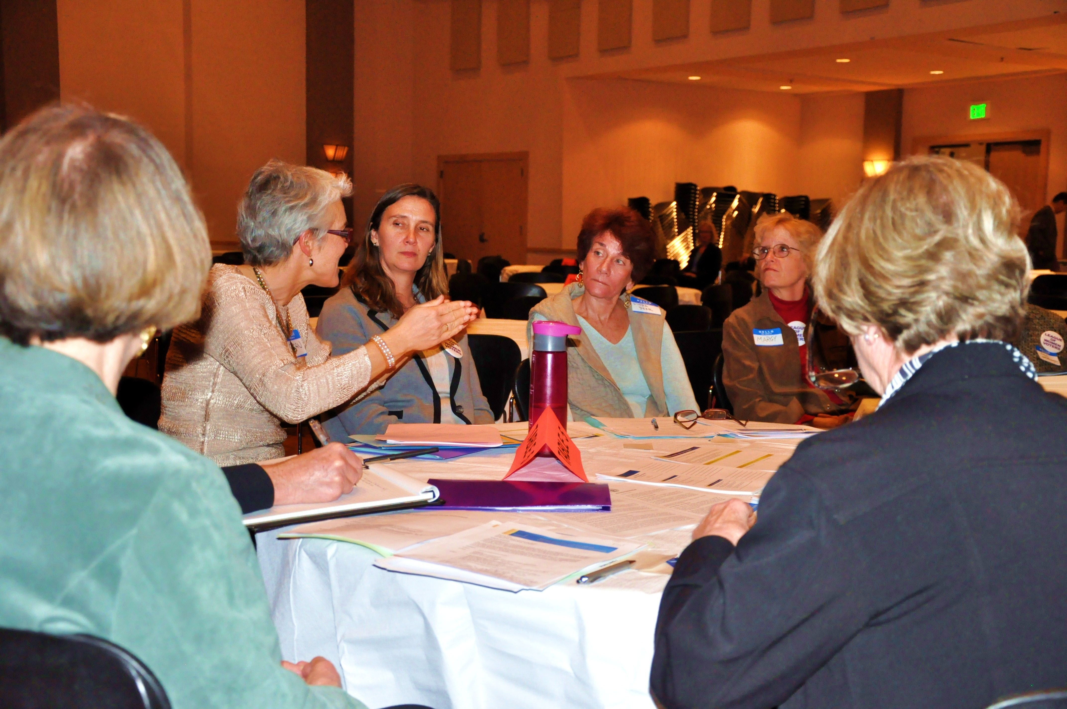
Extra Preparation

Slide 22
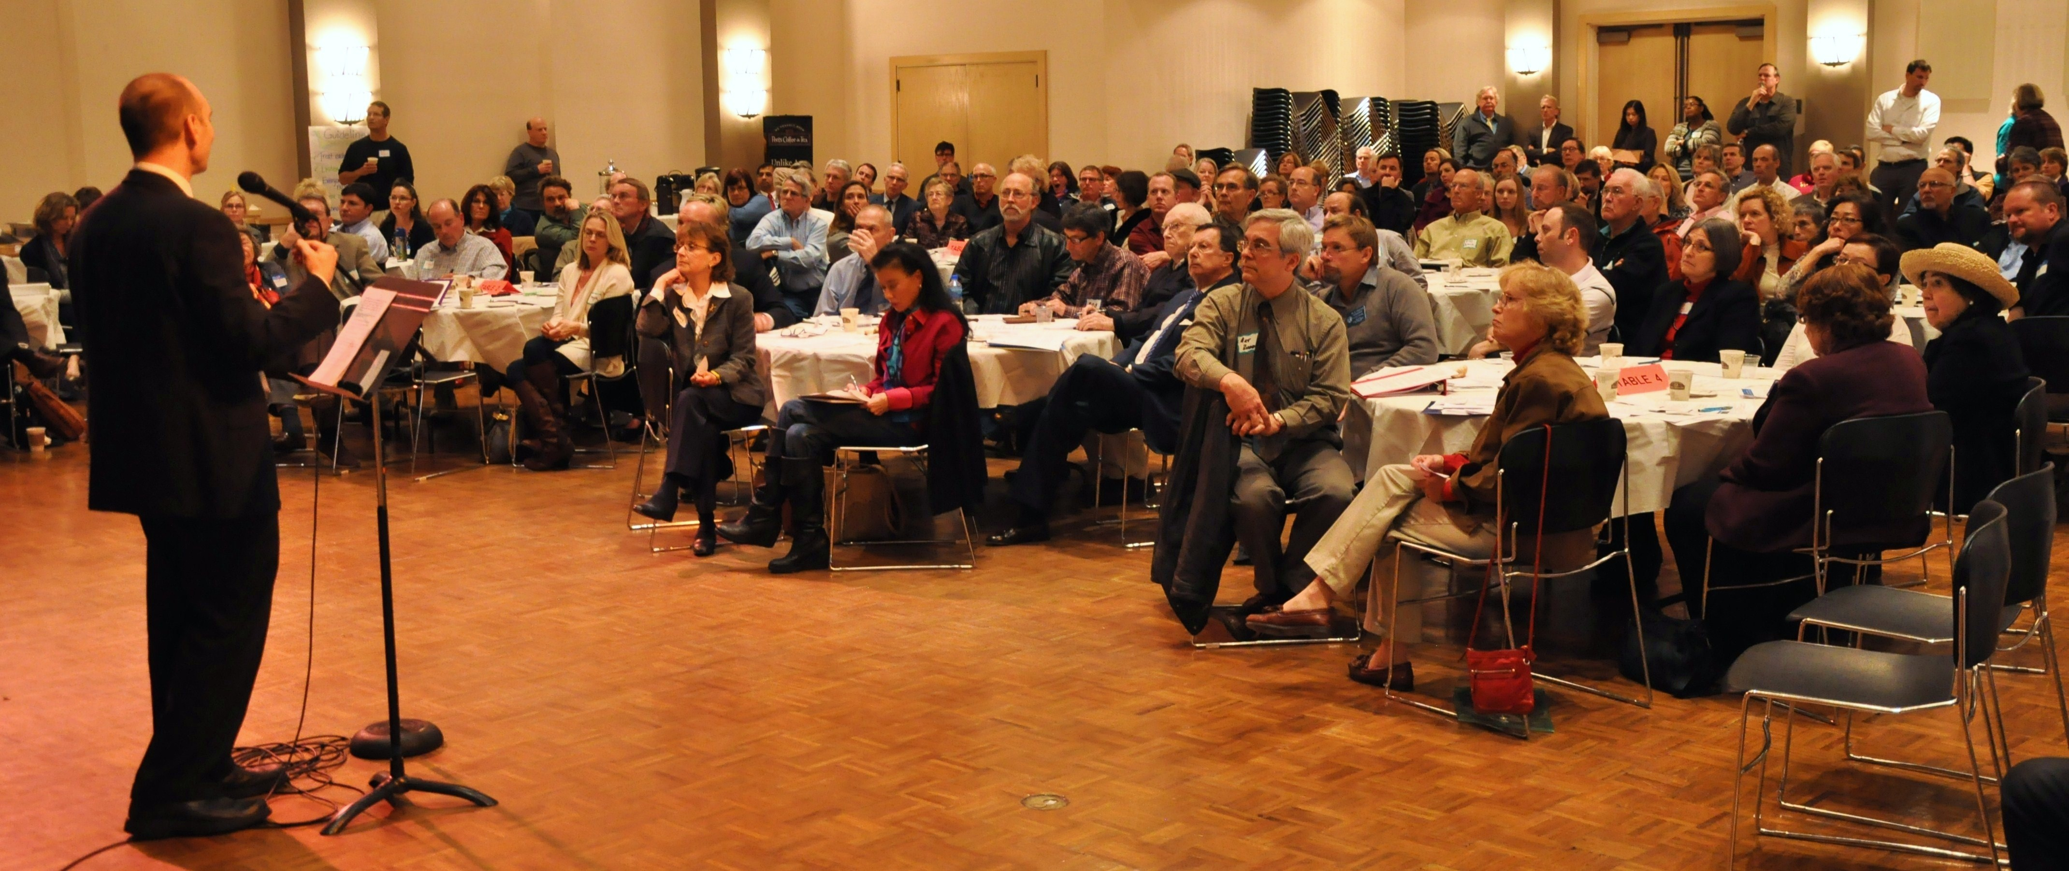
Large Turnout for Evening Forum

Slide 23
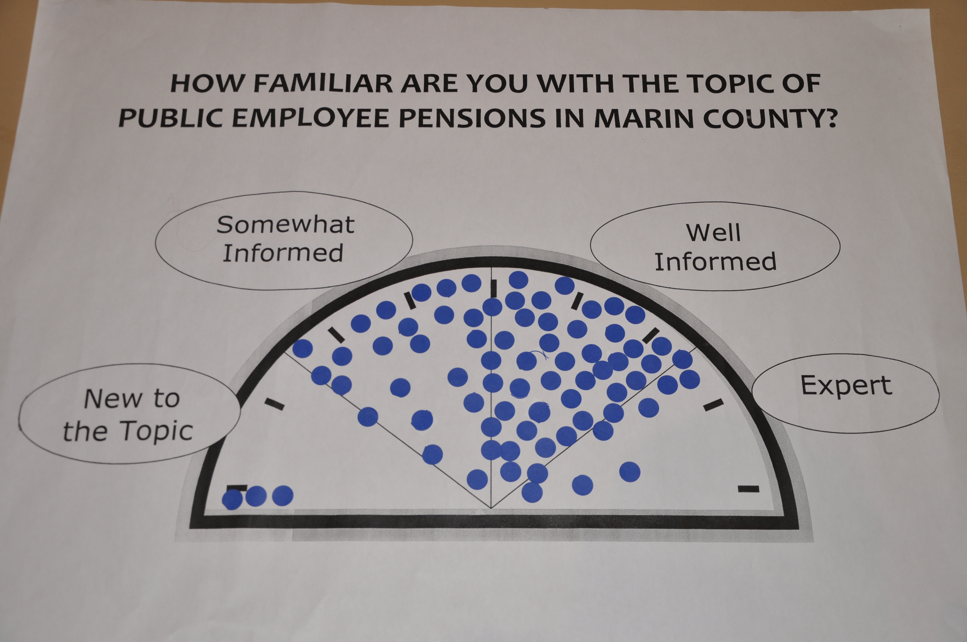
Mixed Knowledge on the Topic

Slide 24
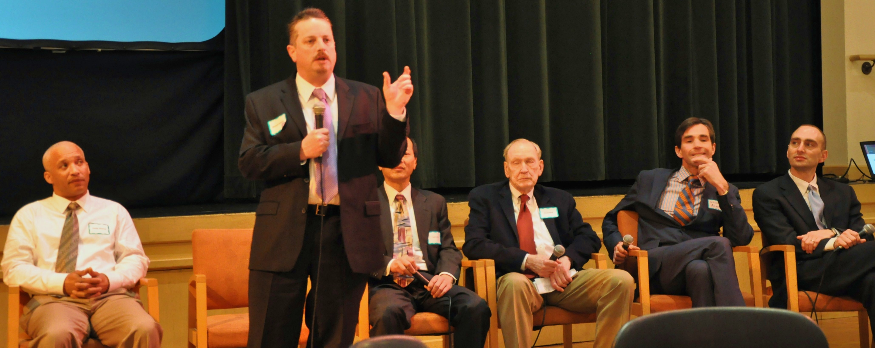
Panel and Audience Questions

Slide 25
Implementation
Rigorously neutral facilitation and clear ground rules
Transparent as to why process is the way it is
Multiple modes for participant input before, during and after
Format adjusted to accommodate widespread need for more information before dialogue
Thorough follow-up: report to BOS, all materials and questions posted online

Slide 26
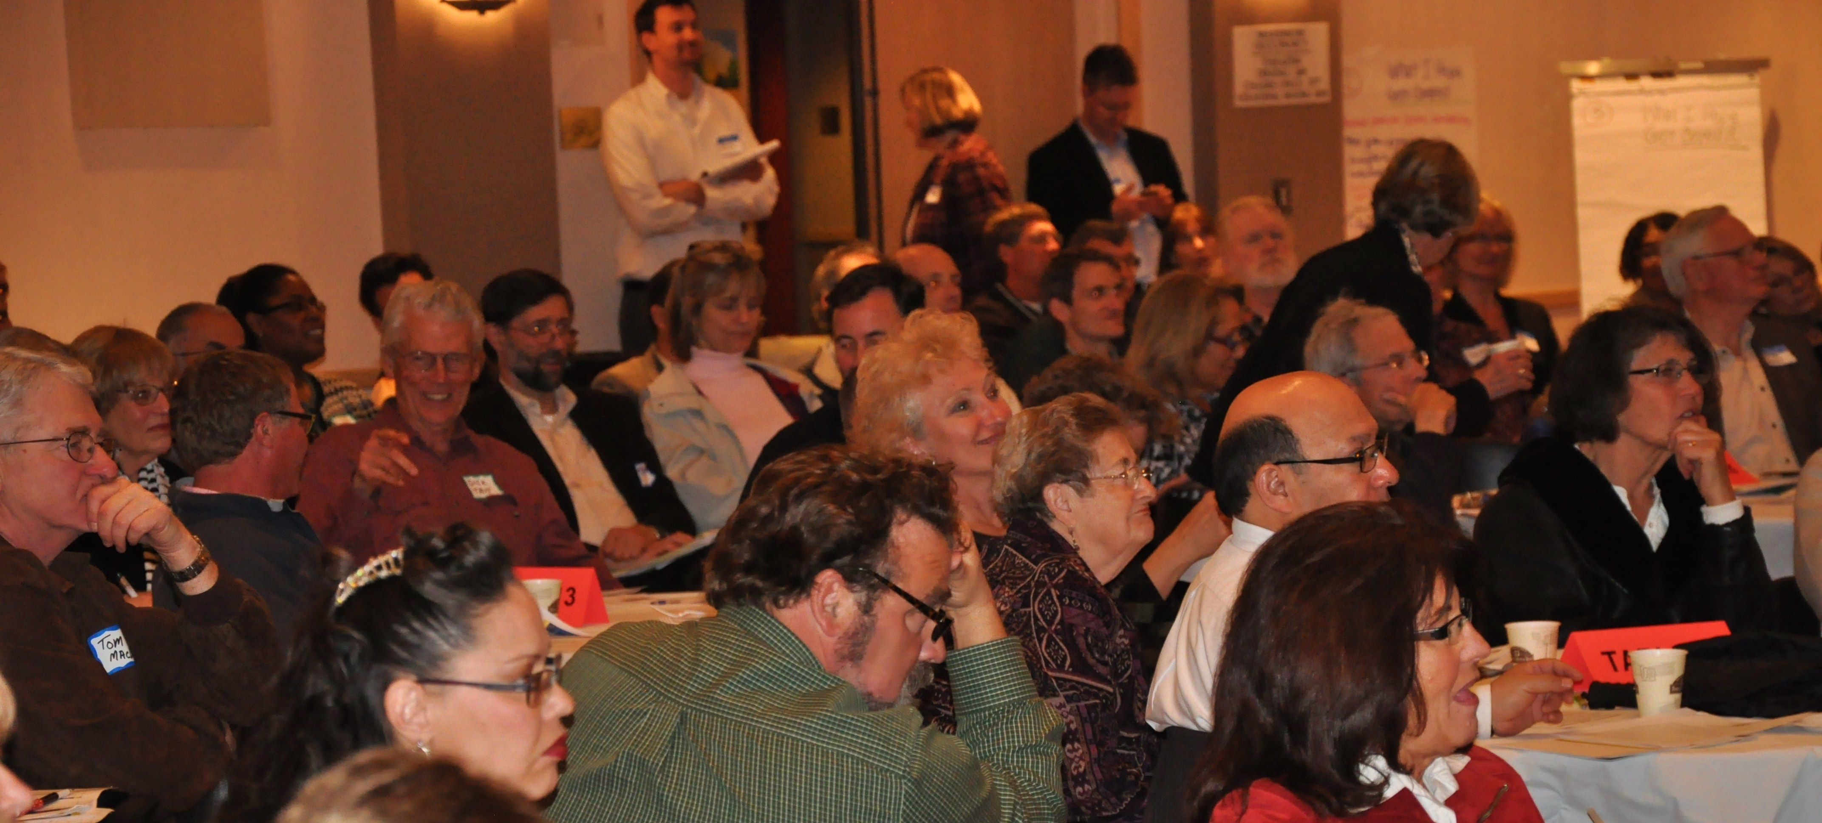
High Levels of Engagement

Slide 27
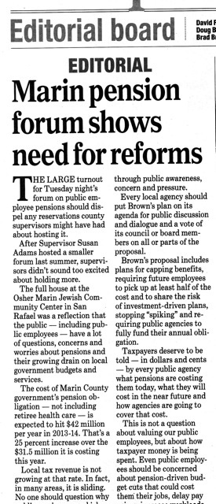
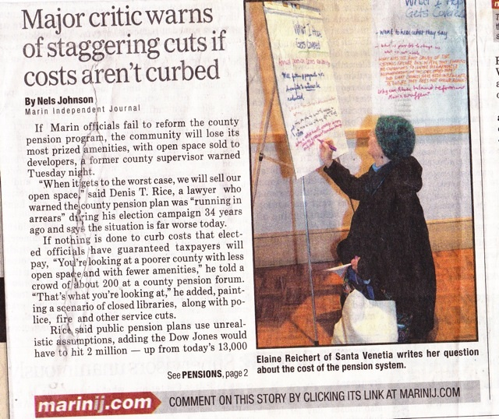
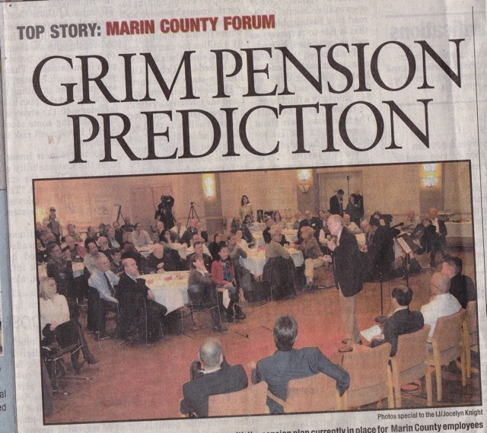

Slide 28
Feedback from the public
Worksheets were used, along with the questions, to surface a range of proposed pension plan changes
CAO reported the key themes and how they related to proposed actions within weeks after the forum
95% of attendees: purpose of the meeting was clear and they had enough information to participate
Other feedback: Enough opportunities to express their views (68%) and it was well-managed (66%)
The panel (81%) and “Basic Facts” (70%) were helpful.

Slide 29
“The large turnout for Tuesday night’s forum on public employee pensions should dispel any reservations county supervisors might have had about hosting it.” Marin Independent Journal
www.marincounty.org/Main/Pensions
www.ckgroup.org

Slide 30
Responding to Contested Views and Values in Public Engagement Processes
Offered by
Christal Love Lazard, Program Coordinator
ILG Public Engagement Program

Slide 31
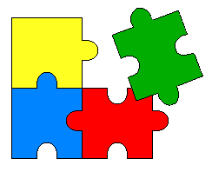
Purpose: To develop your capacity to design and implement public engagement processes with the greatest chance of success when there are strongly contested views and values.

Slide 32


Participants May Have Strongly Held Views About:
The topics to be discussed
The local agency and officials involved and/or
The planning and/or public engagement process(es)

Slide 33

Think About Your Likely Participants
What are possible individual and/or group concerns and interests?
How may they view an opportunity for public engagement?
Are there assumptions/gaps in information?
What are their past experiences in other settings?

Slide 34
Plan, Prepare, and Provide Information
Offer opportunities for early process input and co-sponsorship
Strive for speakers and participants to reflect diverse population & viewpoints
Endure sponsor and facilitator clarity about meeting process & strategy
Plan for/prepare impartial mtg. facilitators
“Watch your language”
Prepare for “What if…”

Slide 35
Design an Appropriate Process
Design in flexibility (have a “plan B”)
Provide info & opportunities for learning
Acknowledge underlying “policy” history, assumptions, restrictions on actions
Meet reasonable process needs/interests of those likely to attend (time for questions)
Consider processes that seek common ground – but allow adequate time
Focus on a do-able work

Slide 36
Manage Public Engagement Meetings Transparently
Describe meeting goals, process, documentation, and what happens next
Seek agreement on meeting ground rules (or “courtesy guidelines”)
Clarify how questions and/or comments will be handled – and comments documented
Allow “none of the above” responses
Show respect, impartiality & good listening

Slide 37
Responding to Negative, Challenging or Emotionally Presented Comments
Remain calm and actively listen
Identify and respond to the substance of the comment rather than to its tone
Ask for more explanation (as appropriate)
Intervene if personal verbal attacks are made
Be aware that people who do not feel heard are likely to speak loudest

Slide 38

Take Steps if Participant Behavior is Disruptive
Review and enforce meeting ground rules
Maintain control of the microphone
Ask group whether they wish to continue -or move to another format or process
Move to “back-up” meeting process
Ask disorderly participants to leave
State next steps; conclude the meeting

Slide 39
Keys to Consider
Learn from others
Think about your likely participants
Ensure clarity among sponsors/facilitator
Inform and include
Practice transparency
Fit the process to the participants
Prepare for “what if…”

Slide 40

Resources
See resources and case stories to support the use of public engagement strategies to address difficult issues and situations http://www.ca-ilg.org/difficult-situations-public-engagement
See resources to promote civility in public discourse http://www.ca-ilg.org/document/promoting-civility-public-discourse
See strategies to deal with emotional audiences http://www.ca-ilg.org/document/dealing-emotional-audiences

Slide 41
Questions & Answers

Slide 42
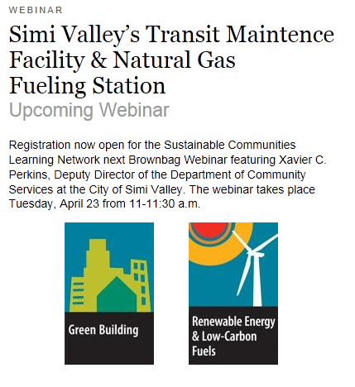
Next Webinar April 23rd
Register Now!
https://www1.gotomeeting.com/register/115319992

