Slide 1

Using Technology and Social Media to Enhance Public Meetings
CSAC Institute, Chairing and Managing Effective Public Meetings
April 26, 2013
Mona Miyasato, Chief Assistant County Administrator, Marin County

Slide 2
Overview
Social and Tech Tools to Enhance Meetings
Communication Systems and Practices
Good Government = Good Communication

Slide 3
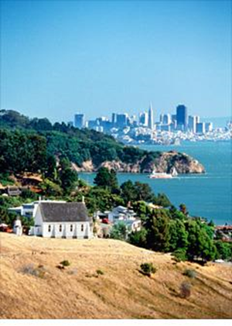
A little about Marin County
Marin County
255,000 population
530 square miles
26% unincorporated
Educated and affluent
Older - 28% over 65
County Government
2,000 FTE
$445 M budget
Our mission includes to “encourage meaningful participation in the governance of the County by all.” Still a challenge!

Slide 4
Broader Context
Info
Better Decisions
Outreach
Transparency
Participation
Discourse
Engagement
Trust in Government
  Before looking at the tools, what’s the purpose?
  Tool is just the means
  Participation continuum

Slide 5
Participation Continuum
Information Sharing
Consultation
Information and Feedback
Engagement
Information, Feedback, and
Interactive
Deliberation
Method depends on the issue, circumstance and your objective
Tech tools = > greater ability in all these

Slide 6
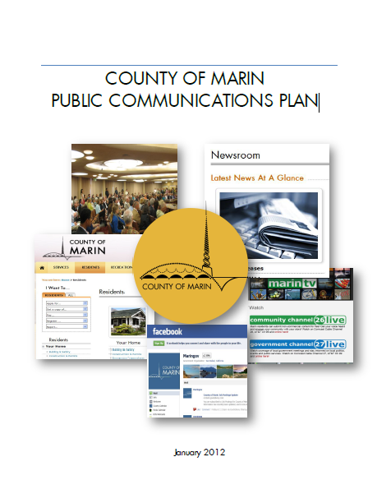

Foundational Pieces
Communication Systems, Policies and Practices
Common direction understood by policy makers (Plan)
Adopted social media policy and “How To” Playbook
Electronic agenda system (meetings, webcasts)
Video production ability
(YouTube Channel)
Adaptive website
Systems for distribution (email lists, newsletters, subscriptions)

Slide 7
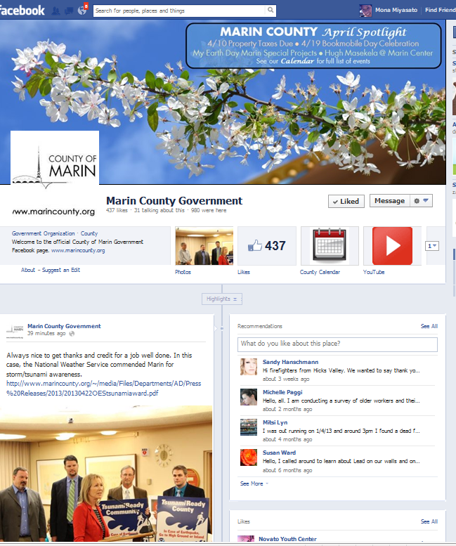
Social – Facebook
89,000– 1 in 3 Marin residents have FB accounts
19 County FB pages
Not a lot of “likes” but…
  Main Marin County page: 1,086 Reach within 1 week
  Parks and Cultural: close to 4,000 Reach each (1 week)
  Most popular post:
    23,144 County Main page (voter guide);
    34,700 for Fair FB site
Notes:
“Reach” – number of unique users seeing any post within a time period

Slide 8
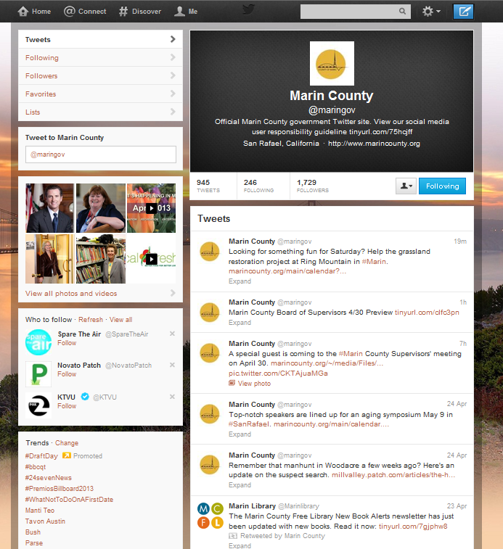
Social - Twitter
7 Twitter accounts in County
1,729 followers for main County of Marin site
Increased over past year
Preferred for County news

Slide 9
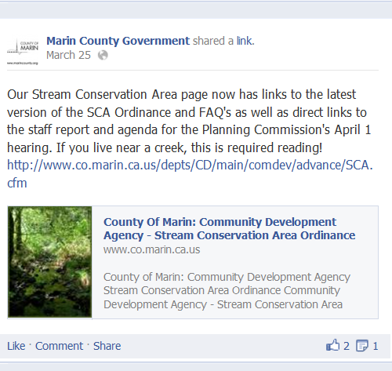
How we use social media
Facebook and Twitter posts
  Before and after meetings
    Announcements of meetings
    Upcoming events or stories
  Drive traffic to website for more info
  Tone
  Photos on FB
  Don’t fear Comments
  Link to other media
  Use for items not significant enough for media releases but important
  Ads

Slide 10
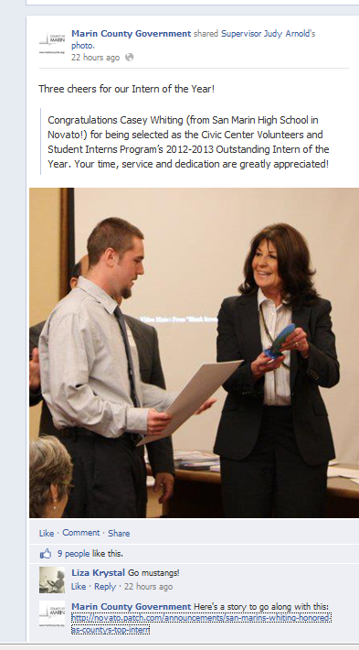
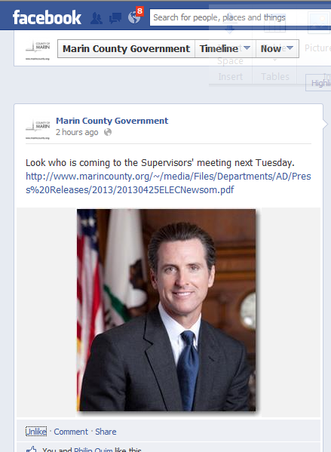
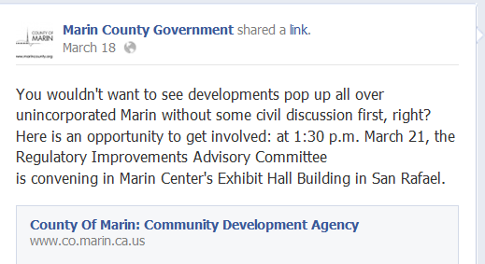
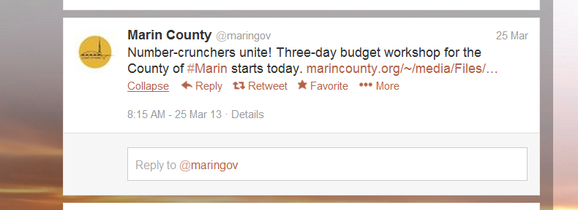

Slide 11
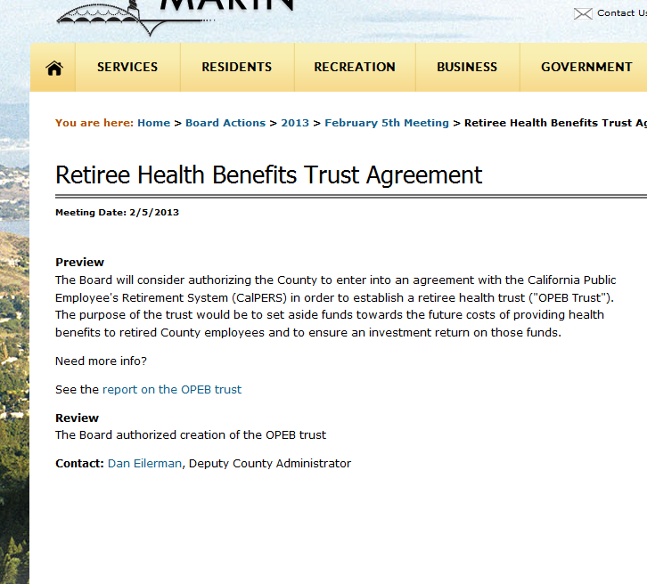
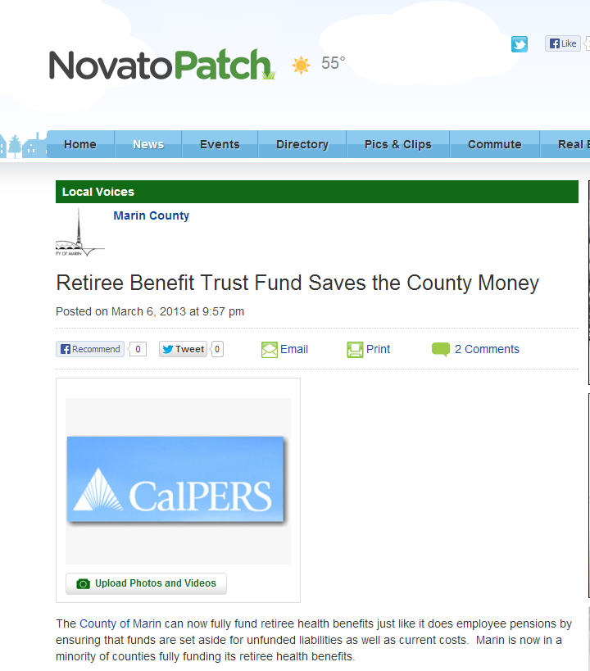
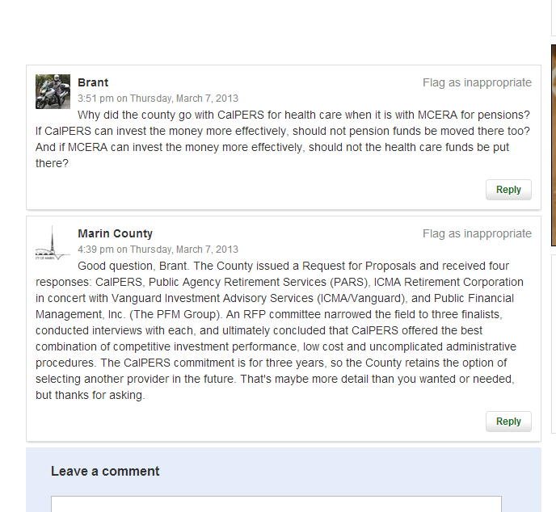
Use others’ websites
Post on other news sites if they allow
Patch.com
Be responsive to those audiences

Slide 12
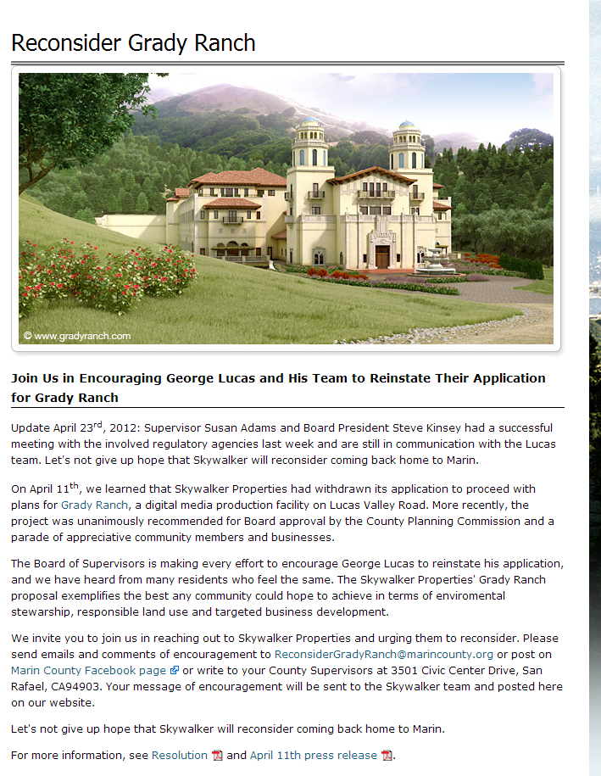
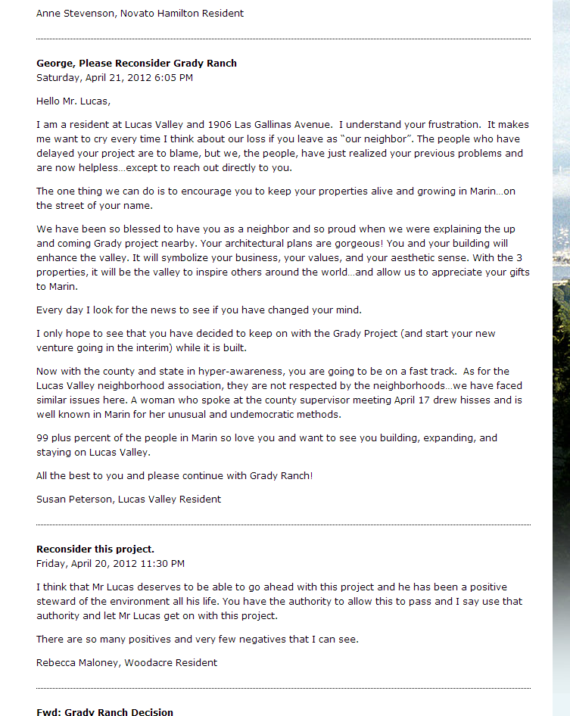
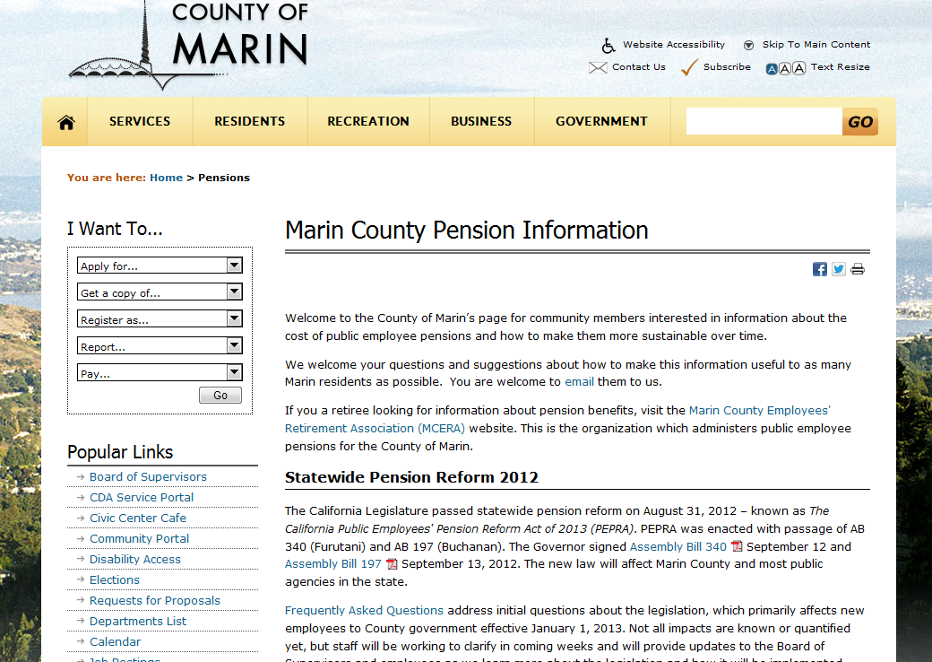
Use the web
  Special web pages in conjunction with hot item or meeting
    More information
    Complicated topic
    Broad appeal (not everyone on FB or Twitter)
    Unique URL
  Get input
    Grady Ranch – post meeting for info and input
    Pension

Slide 13
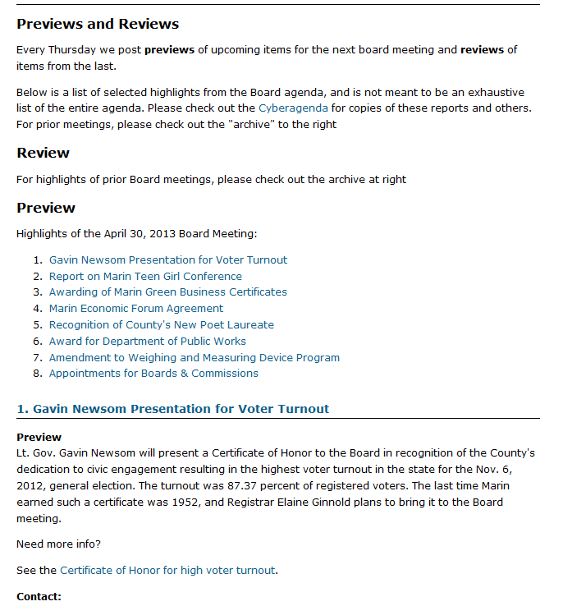
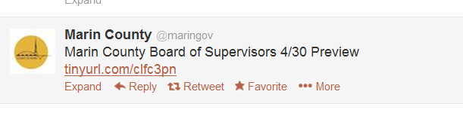
Other Tools
    Reviews and Previews - Summary of major items on upcoming agenda and review of last meeting
    Web
    Distribute to press
    Twitter
    Facebook
    By subscription
    Review-Preview of April meeting

Slide 14
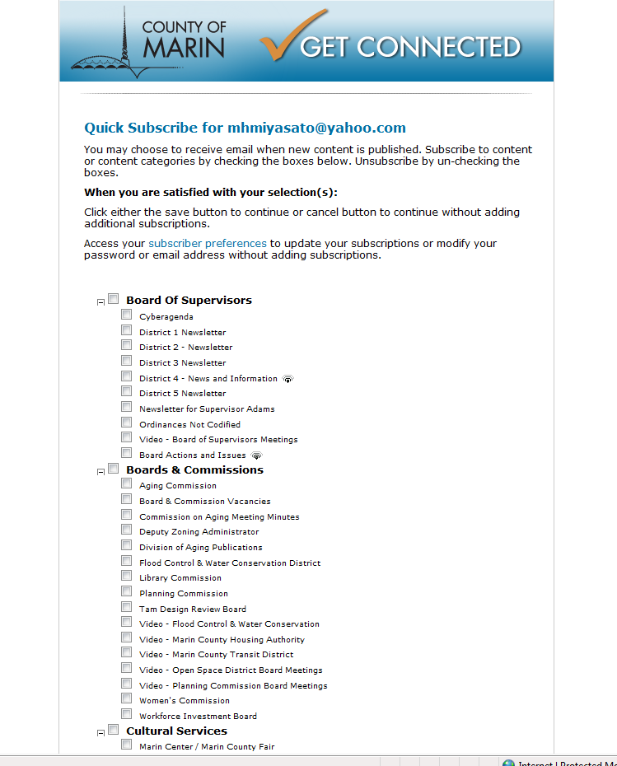
Other Tools
GovDelivery = 74,000 subscribers (unique emails)
Number of topics = 153
Number of bulletins (last year) = 653

Slide 15
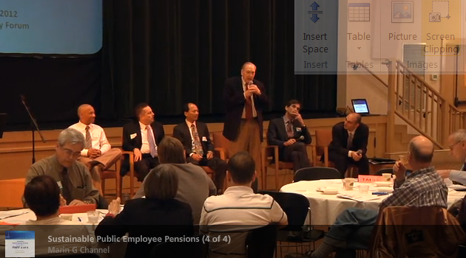
Video
Video to document meeting
Pension Forum wrap up
Replay for emphasis
Foreshadow or advertise action at meeting

Slide 16
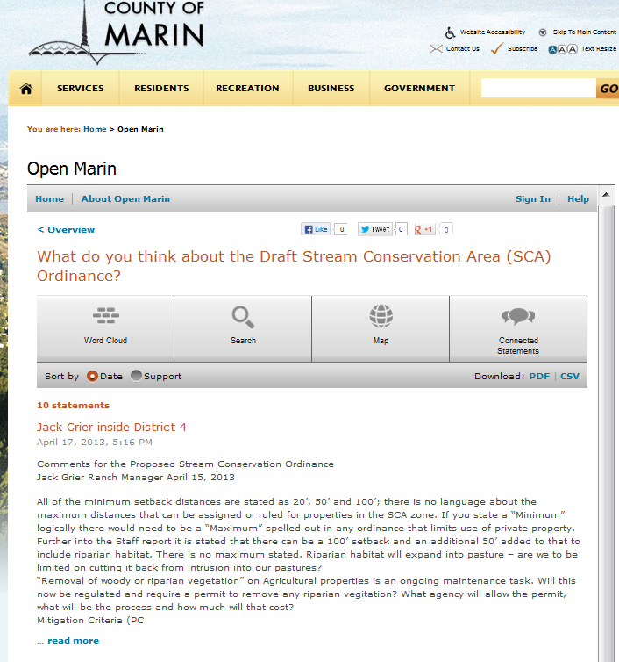

Other Tools
OpenMarin
One month opened
One topic so far
141 total unique visitors to the site.
13 of those visitors have subscribed and participated
openmarin

Slide 17
Questions?

