Slide 1
Local Government Basics
Understanding California’s System of Local Government

Slide 2
Who We Are:
Institute for Local Government
501(c)(3) affiliate of two major associations of local government agencies
Promote good government at the local level
Government that enjoys the public’s trust and confidence

Slide 3
Types of Local Governments

Slide 4
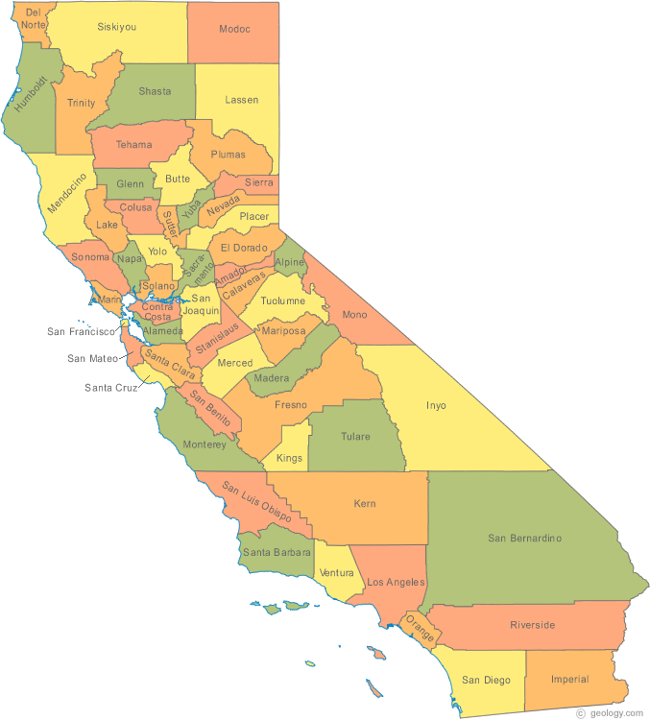
Types of Local Governments
Counties
Cities
Special Districts

Slide 5
Counties
58 counties
  Boundaries determined by state law
Two Roles:
  Agent of state/administer countywide programs
  General purpose government for unincorporated areas

Slide 6
Counties, continued
County-wide services:
  Health, welfare and social services
  District attorney
General purpose government:
  Services: Sheriff, parks and recreation, fire protection, solid waste collection to unincorporated areas only
  Regulations: Land use and other regulations in unincorporated areas

Slide 7
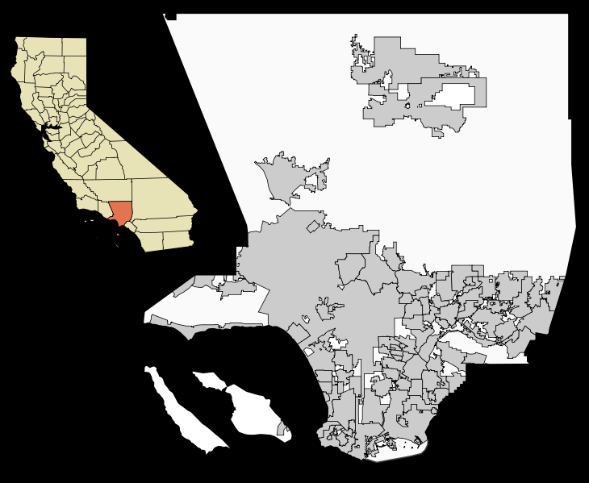
Unincorporated versus
Incorporated Areas
White= unincorporated
Gray= incorporated

Slide 8
Cities
482 cities in California
  Created when residents in county areas choose to incorporate
Role
  Provide services and regulate conduct

Slide 9
Cities, continued
Services:
  Police and fire, animal control, parks and recreation, water, solid waste, library
Regulation:
  Adopt land use and building regulations
  Other local legislation/regulations

Slide 10
Types of Local Regulation
Public Safety: Curfews, anti-gang measures
Land Use: Planning and zoning laws, historic preservation, sign regulations
Business Regulations: Adult entertainment, rent control, parking requirements

Slide 11
Special Districts
5,000 special districts
Organized for specific purposes: water, sewer, fire protection
Provide these services within a city or within a county
School districts are special districts

Slide 12

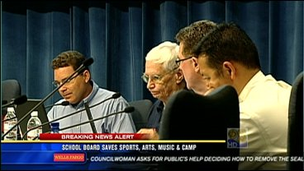
Schools
Hybrid
  Funded and part of state system
  Locally elected boards exercise some control

Slide 13
People Who Serve in Local Governments

Slide 14
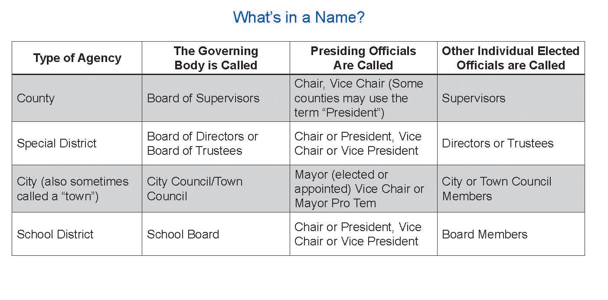

Slide 15
Common Staff Positions

Slide 16
Division of Labor
Role of Elected Officials
  Policy Direction
  Budget Decisions
Role of Staff:
  Recommendations on policies
  Implementation of policies adopted

Slide 17
The Public’s Role in Decision-making
Initiative—When the public proposes and adopts laws
Referendum—When the public rejects laws adopted by elected officials
Recall—When the public votes elected officials out of office (not as part of the election cycle)

Slide 18
Funding and Revenues

Slide 19
Types of Revenues
Taxes
Service charges, assessments and fees
Revenues from other government agencies
Rents from use of public property
Fines, forfeitures and penalties

Slide 20
Taxes
Property tax
Sales tax
Business license
Hotel tax
Utility user taxes
Transfer tax
Parcel tax

Slide 21
Service Charges,
Assessments and Fees
Utility rates
Benefit assessments
User fees
Regulatory Fees
Development Impact Fees

Slide 22
Revenues from
Other Government Agencies
Gas tax
Motor vehicle license fee
Health and welfare realignment
State and federal grants

Slide 23
Rents for Use of Public Property, Including Streets
Earnings on investments
Rents, royalties and concessions
Franchise fees

Slide 24
Fines, Forfeitures and Penalties
Amounts paid when someone violates the law
Violations of state laws
Parking fines
Violations of local ordinances

Slide 25

Questions?

